Slide 1


Introduction to Linux
Gildas Hounmanou, PhD
APTI-Fellow, National Institutes of Health, MD, USA
Assistant-Professor
https://orcid.org/0000-0003-3991-0864
University of Copenhagen
Faculty of Health and Medical Sciences
Section for Food Safety and Zoonoses
Department of Veterinary and Animal Sciences
WORKSHOP ON BIOINFORMATICS APPLICATIONS IN GENOMICS SURVEILLANCE OF BACTERIAL ANTIMICROBIAL RESISTANCE
22-24 February 2023, Yaoundé, Cameroon

Slide 2
Learning outcomes
Understand the Linux file structure
Understand the command line structure and learn basic commands
Learn how to create, access files and directories and navigate through them
Learn how to read files content and extract information from them
Learn how to combine commands and redirect outputs
Learn how to manage files permissions

Slide 3
Course structure
Part I: Introduction to Linux and Unix and the command line
Part II: Manipulating and extracting information from files
Part III: File permissions Part IV: Practicals

Slide 4
Part I:
Introduction to Linux and Unix and the command line

Slide 5
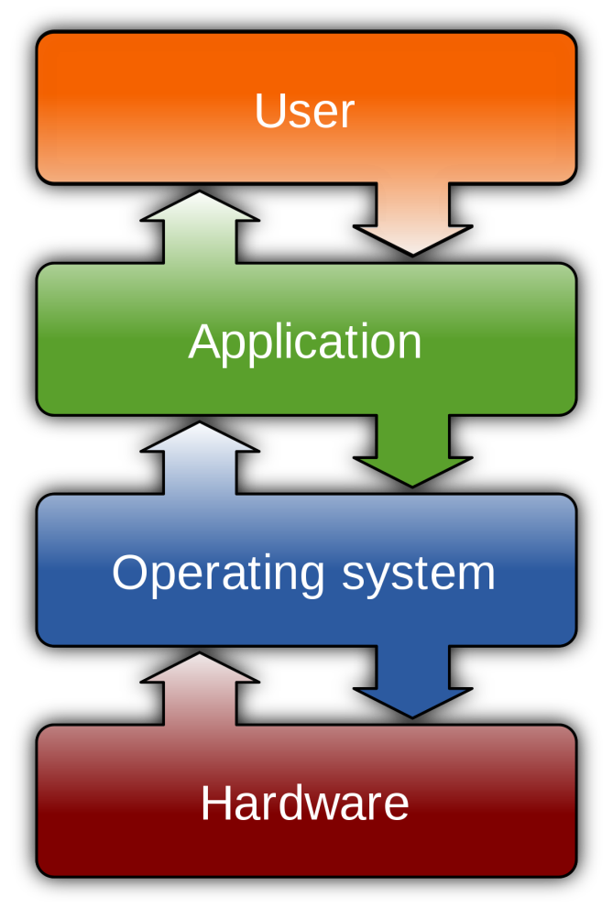
What is Linux?
UNIX is an Operating System (OS) initially developed in the 1960
OS: software that supports the computer’s basic functions
There are many different versions of UNIX, that share many
similarities
The most popular varieties of UNIX are Linux and MacOS
UNIX systems have a graphical user interface (GUI) making easier the environment
https://en.wikipedia.org/wiki/Operating_system

Slide 6
Why Linux?
Unix is particularly suitable for working with big files and has several powerful and flexible commands that can be used to process and analyse this data.
One advantage of learning Unix is that many of the commands can be combined in an almost unlimited fashion
Unix is the standard operating system on most large computer systems in scientific research, in the same way that Microsoft Windows is the dominant operating system on desktop PCs
Linux is free and the most popular distributions are Ubuntu, Fedora/Red Hat, Mandriva, etc.
Very stable, secure and fast developing OS (many developers)
Best multi-user and multi tasking OS, this is why it is the preferred operating system for large-scale scientific computing.

Slide 7
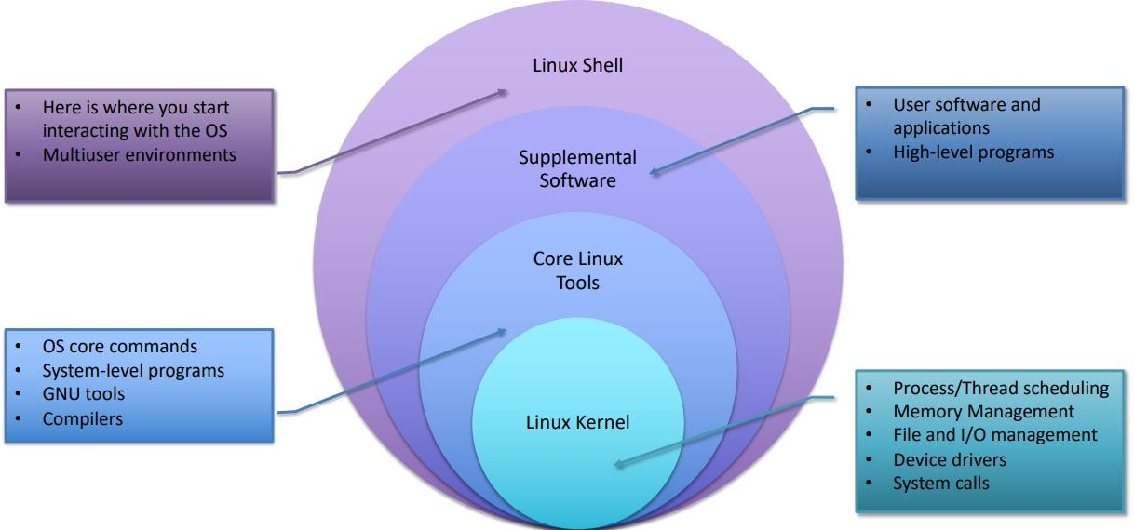
Structure of Linux

Slide 8
Linux Shell and terminal
The shell is a program that takes commands from the user’s keyboard and passes them to the operating system to execute
There are many different Unix shells
The most popular shell for interactive use include Bash: the default on most Linux installations
A terminal refers to a wrapper program (the “black window”) that opens in a window
and lets users interact with the shell.
The shell prompt (or command line) is where one types commands
User name
System name
Name of the current directory (~)

Slide 9
Working with files and directories
Linux file structure
Home directory
When you first log in on a UNIX system, the
working directory is your home directory.
/
Root directory of the entire file system
Users home directories
home
dev
bin
ect
Configuration files
Device files
Essential user commands binaries
manager
Working or current directory
While working you will be associated to one directory called the working directory or the current directory
Desktop
CBE_course
Documents
data
practical
lecture
Directories files
An abbreviation of the working directory is displayed as part of the prompt on your terminal
Test_file.pdf
Notebooks
Ordinary file

Slide 10
Understanding path and pathname
Absolute path:
File hierarchy starting from the root
Relative path:
File hierarchy starting from the current working directory
. (dot): the current directory
.. (dot-dot): the parent directory
/
home
manager
CBE_course
Desktop
CBE_course
Documents
annotation
Practical
. ..
data
practical
lecture
Current working directory
Test_file.pdf
Notebooks
Test_file.pdf
Notebooks
The full path to test_file.pdf is:
The relative path to test_file.pdf is:
/home/manager/CBE_course/practical/Test_file.pdf
./Test_file.pdf

Slide 11
Part II:
Manipulating and extracting information from files in Linux

Slide 12
Commands basic structure
Command
A command is a program that
you are running
[–options]
Option tells a command how to operate and starts with a dash
[arguments]
The argument tells a where to operate the command
ls grep tail rm
-lh
-i “gene”
-n
-r
/home/manager/CBE_course/
/home/manager/CBE_course/practical/Test
_file.pdf
/home/manager/CBE_course/practical/Test
_file.pdf
/home/manager/CBE_course/practical/
Example:
ls –lh /home/manager/CBE_course/
grep –i “gene” /home/manager/CBE_course/practical/Test_file.pdf tail -5 /home/manager/CBE_course/practical/Test_file.pdf

Slide 13
Key commands for handling directories
Command Description
pwd Prints or displays the absolute path Current Working Directory
Command structure: pwd
cd Change directory: allows moving from one directory to another
Command structure: cd <path>
The path name of the directory you want to move to should be specified You can specify either the absolute path or the relative path
Useful tips: cd without specifying any path move back to the home directory
ls Lists a directory content
Command structure: ls [OPTION] [dirname]
Some useful options:
-l: shows sizes, modified date and time, file or folder name and owner of file and permissions
-a: List all files including hidden file starting with ‘.’
-lh: shows sizes in easier readable format
-lS: sorting by file sizes
13

Slide 14
Key commands for handling directories
Command Description
mkdir Make directory: creates a new directory
Command structure: mkdir dirname [path]
mkdir dirname: would create a directory with the specified dirname
The newly created directory will be created in your current working directory
If you want to create it elsewhere, you have to specify the path: mkdir dirname path
rmdir/rm -r Removes a directory
Command structure: rmdir dirname [path]
It would remove the dirname directory only if empty
If the directory is in your current working directory, it is not necessary to specify the path
If the directory is not empty, you can use rm with option -r, which stands for recursive, that will recursively remove a directory and its contents
history To see the command you have typed so far
It allows you to see the command you have typed and save it in a separate file if needed
14

Slide 15
Basic manipulating file commands
Command Description
nano It is a simple and easy-to-use text editor
Command structure: nano filename [path]
Type the content of your file and once you finish typing, hit Ctrl+x to save and exit
cat Concatenates and prints the contents of a short file
Command structure: cat filename [path]
more View the content of a long file and navigate through it
Command structure: more filename [path]
less View the content of a long file, by portions
Command structure: less filename [path]
Move a page down: either use the page down key or space To exit less, type q and type g to go to the end of the text file
head/tail View the first or the last lines of a long file
Command structure: head <option> <filename>
By default: 10 last lines at a time (use –n to change the number of lines you want to display)
15

Slide 16
Basic manipulating file commands
Command
Description
cp Copy files and directories
Command structure: cp <pathfrom> <path to>
Examples of application:
cp file1 file2 (Copy the contents of file1 into file2. If file2 does not exist, it is created)
cp filename dirpath (Make a copy of the file or directory into the specified destination directory)
mv Moves or renames files and directories depending on how it is used
Examples of applications:
mv -i filename1 filename2 (to rename a file; the -i will avoid overwriting file2 if it does exist)
mv filename dirpath (to move a file or directory to another directory)
mv file1 file2 file3 dirpath (to move different files or directories to another directory)
wc Word counts: Prints new line, word, and byte counts for each file
Command structure: wc <option> <filename>
Some useful options:
-c: print the byte counts
-m: print the character counts
-l: print the newline counts
16

Slide 17
Extracting data from files
Command
Description
grep
Global Regular Expression Profile” is used to search for the occurrence of a specific pattern (regular expression…) in a file
grep outputs the whole line containing that pattern Examples of application:
grep gene <filename> (Extract lines containing the term gene from a specific file)
grep -v gene <filename> (Extract lines that do not contain the pattern gene from a specific file)
grep -i gene <filename> (Ignore case distinctions in both the PATTERN and the input files)
cut Used to extract specific fields from a file
Command structure: cut <option> <filename>
Important options are
-d (field delimiter)
-f (field specifier) Example:
cut -d‘ ’ -f2,3 <filename> (extract fields 2 and 3 from a file having ‘space’ as a separator)

Slide 18
Part III:
File permission in Linux

Slide 19
File System Ownership and Permissions
All files and directories have individual and group ownership.
All files and directories have read (r), write (w), and execute (x) permissions assigned as octets to the individual owner (u), the group (g) owner and all others (o) that are logged into the system.
You can change permissions if you are the individual owner or a member of the group.
Only the root user can change ownership.

Slide 20

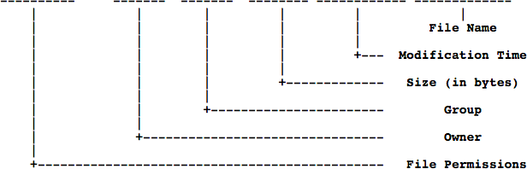
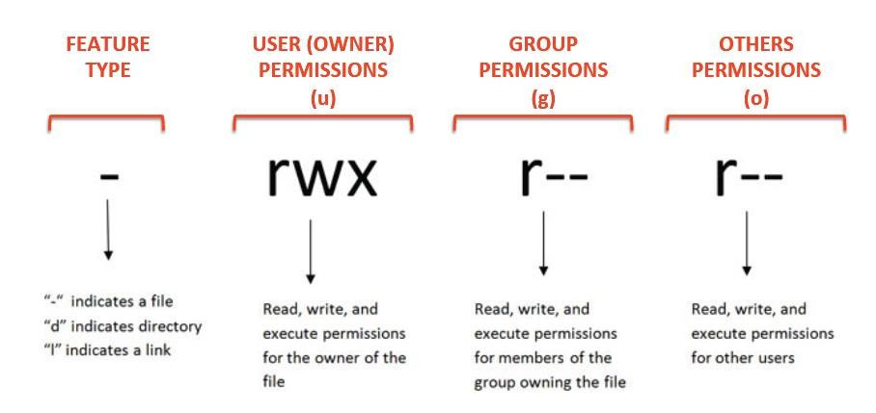
Description of file permissions
Description of files and directories using ls -l
Permissions are broken into 4 sections
20

Slide 21
Access permissions on files
r indicates read permission: the permission to read and and copy the file
w indicates write permission: the permission to change a file
x indicates execution permission: the permission to execute a file, where appropriate

Slide 22
Access permissions on directories
r indicates the permissions to list files in the directory
w indicates that users may delete files from the directory or move files into it
x indicates means the right to access files in the directory. This implies that you may read files in the directory provided you have read permission on the individual files

Slide 23
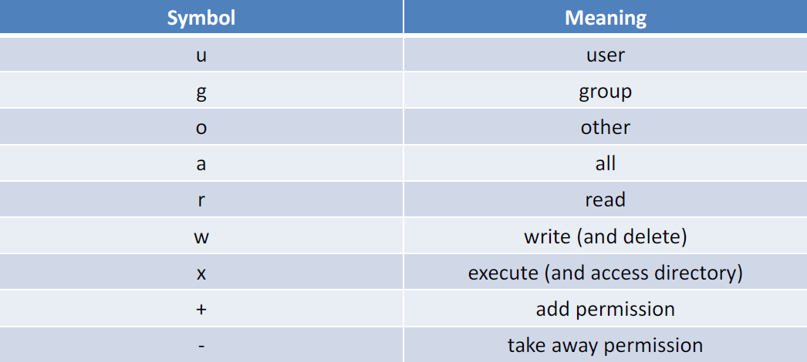
chmod command
It is used to change the permissions of a file or a directory.
Syntax: chmod options permissions filename
Example: chmod u=rwx,g=rx,o=r filename
Users can read, write and execute, the group to which the user belong can read and execute and the others can only read
23

Slide 24
Few tips
Use tab completion - it will save you time!
Build commands slowly!
man the_name_of_a_command often gives you help
Always have a quick look at files with less or head to double check their format
Watch out for data in headers and that you don’t accidentally grep some if you don’t want them
If you did something smart but can’t remember what it was, try typing history
Google is normally better at giving examples (prioritise stackoverflow.com results, they’re
normally good)

Slide 25
Part IV: Practical

Slide 26
Practical #1
/
Reproduce the file structure below on your computer
Return to your home directory
Create a new directory in “practical” and name it “exercise1”
Go into the “exercise1” directory
Create a new text file and name it “test1.txt”. Then add the
following lines to the file:
Exercise #1:
My name is xxxx (your name)
I am a xxxx (fonction) at (institution)
I am attending my first Linux course
Thank you to the CBE course team for giving me this wonderful opportunity
Now create a new directory under the “exercise1” directory and
name it “subdir1”.
Go into the “subdir1” and try to print the content of “test1.txt” on
your terminal.
Return to the “exercise1” directory and count the number of
lines in “test1.txt”.
home
manager
Desktop
CBE_course
Documents
data
practical
lecture
Test_file.pdf
Notebooks
26

Slide 27
Practical #2
Return to your home directory
Create a new directory in “practical” and name it “exercise2”
Go to the “exercise2” directory
Copy the “test1.txt” file from the “exercise1” directory to the “exercise2” directory
Make a new directory under “exercise2” and name it “subdir2”
Rename the file “test1.txt” to “test2.txt”
Move the “test2.txt” into the “subdir2” directory
Extract lines containing the pattern “Linux”. How many lines are outputted?
Extract lines containing the pattern “I am” and redirect the outpout to “grep.out” file
Tips: use the greater than “>” sign
Count the number of lines containing the pattern “I am”. Try doing it in a single command
Tips: use the pipe “|” command to combine two commands in one (use the output of one command as the
input of the next command)
9. Remove everything under the “exercise2” directory

Slide 28
Practical #3
Set the “exercise1” directory as your working directory
Try the following command in your virtual machine
ls –lh exercise1 chmod g+w test1.txt ls –lh test1.txt
chmod ugo+x test1.txt
ls –lh test1.txt
chmod ugo+w subdir1
ls –ld subdir1
chmod a-w
What did you notice at each step?

Slide 29
Exercise 1
In the next 5 min browse different directories by using cd, ls and pwd commands
Go into the directory where you stored your fasta files from the previous homework
Look at one chosen document
Less filename.fasta
#scroll with down key through the document
#press q to quit
#look at the beginning/end of the document
head/tail filename.fasta
#terminate any action – panic buttons ☺
#press ctrl+c

Slide 30
Exercise 2
Go into the “Downloads” folder of your computer
Make directory mkdir covid
Go to the just created covid/ directory
Download SARS genomes from NCBI with wget
Go back to ENA first
Use genomes from the accession number PRJEB40443
Assemble two genomes on CGE with SPAdes
Find how many contigs are in each of your .fasta files
grep –c ’>’ filename.fasta

Slide 31


Gildas Hounmanou, PhD
APTI-Fellow, National Institutes of Health, MD, USA
Assistant-Professor
https://orcid.org/0000-0003-3991-0864
University of Copenhagen
Faculty of Health and Medical Sciences
Section for Food Safety and Zoonoses
Department of Veterinary and Animal Sciences

